Slide 1
Part 3:
What Happens at a Women's Wellness Exam
Notes:
Soma to introduce herself / her credentials​

Slide 2
Women's Wellness Exams are an opportunity to review the overall health of a woman.
Notes:
In the U.S., doctors recommend that women who have sex or who are over the age of 21 have a “Women’s Wellness Exam” every year. Women’s wellness exams are an opportunity to review the overall health of a woman. This includes physical health, mental health, and social situation.​

Slide 3
Women's Wellness Exams are an opportunity to review the overall health of a woman.
MAY INCLUDE:
Height and weight check, blood pressure and pulse check, vaccine review, or other tests
Notes:
The physical exam may include a check of your height and weight, your blood pressure and pulse, a review of your vaccines and other tests based on how you feel. ​

Slide 4
WOMEN'S WELLNESS EXAMS USUALLY INCLUDE:
Breast exam
Pelvic exam
Pap test
Notes:
These exams also usually include three things: a breast exam, a pelvic exam, and a pap test. ​

Slide 5
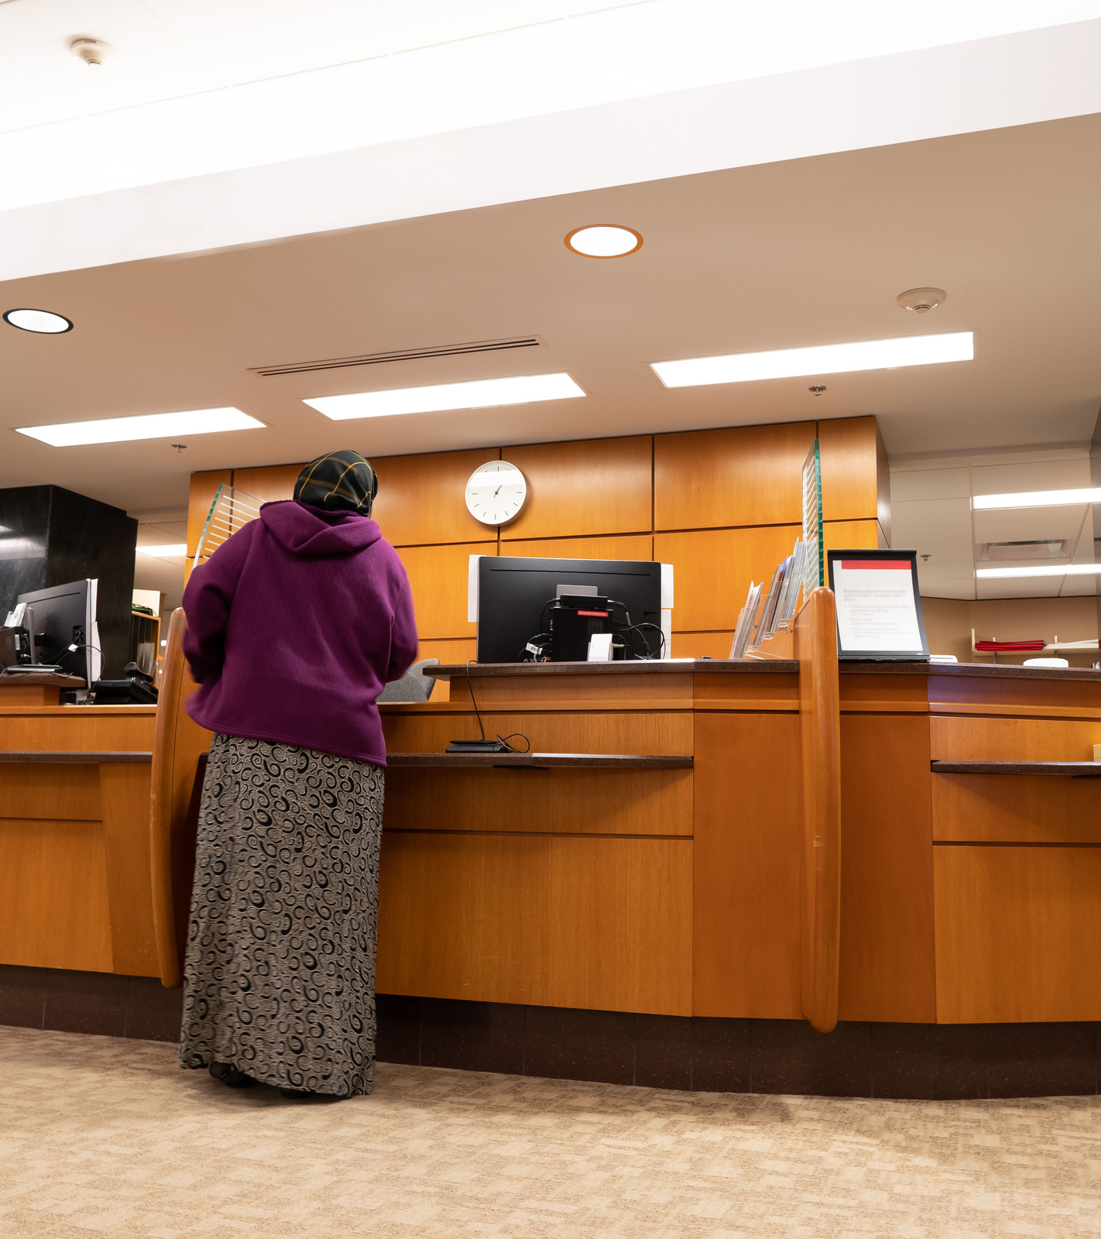
STEP 1
Check in at the front desk
Notes:
The first thing that happens at a Women’s Wellness Exam is checking in at the front desk. This means you go to the front desk and give the staff your name so they know you have arrived. ​

Slide 6
STEP 2
Fill out necessary paperwork
Notes:
The staff may give you paperwork to fill out with questions about your family medical history, any medications you are taking, general demographic information, your menstrual cycle, whether or not you have had sex, and if you have been pregnant before. ​

Slide 7
REMEMBER:
Ask for an interpreter if you need one—your medical provider is required to provide care you understand.
Notes:
If you need help reading and filling out the paperwork in your language, an interpreter should be able to help you. If an interpreter is not there in person or needs to be called over the phone, hold onto the paperwork until the interpreter is on the phone.​

Slide 8
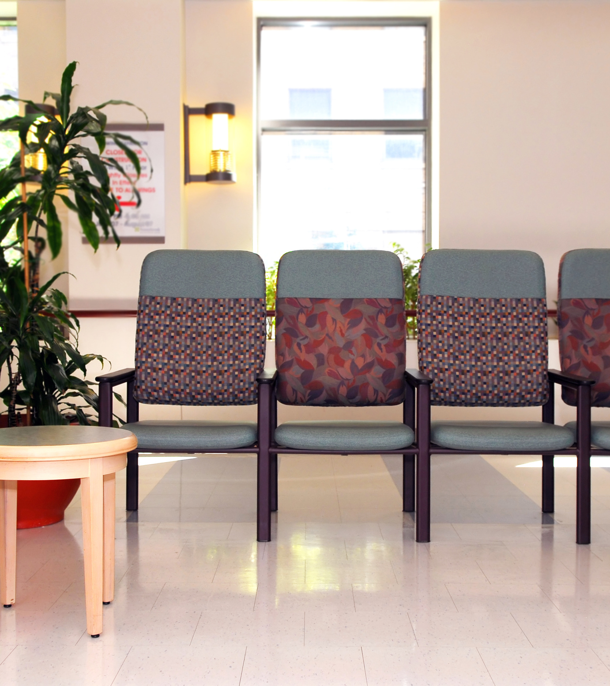
STEP 3
Wait in the lobby for your turn
Notes:
After checking in, you will wait in the lobby for your name to be called. When your name is called, a medical assistant or nurse will accompany you into the exam area of the clinic...​

Slide 9
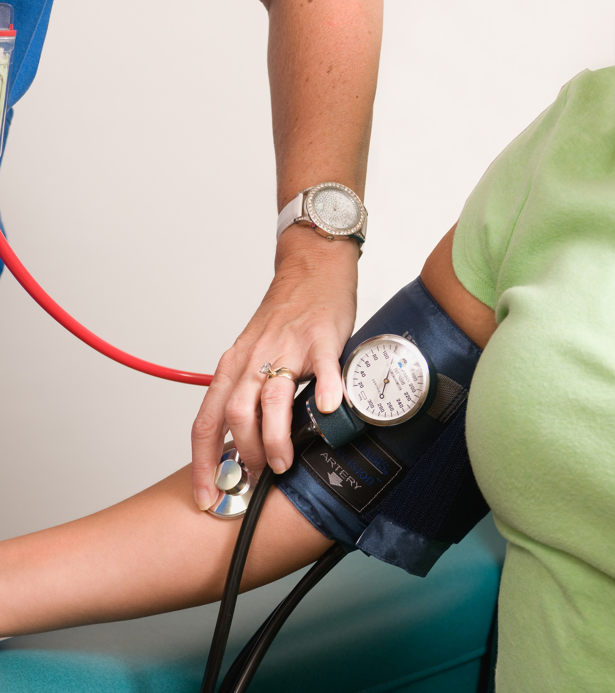
STEP 4
Have your vital signs checked
Notes:
...and take your height, weight, and blood pressure. They will also ask you about your health concerns, your medical history, and your family’s medical history. This information will be given to the medical provider. ​

Slide 10
STEP 5
Change into a medical gown
Notes:
Before the examination, the medical assistant or nurse will provide you with a medical gown to change into. They will leave the room to give you privacy while you change. Once you are ready, you can sit and wait on the exam table.​

Slide 11
STEP 5
Change into a medical gown
PAPER SHEET
Notes:
There is often a paper sheet on the exam table, which you can unfold and place over your lap for more privacy.​

Slide 12
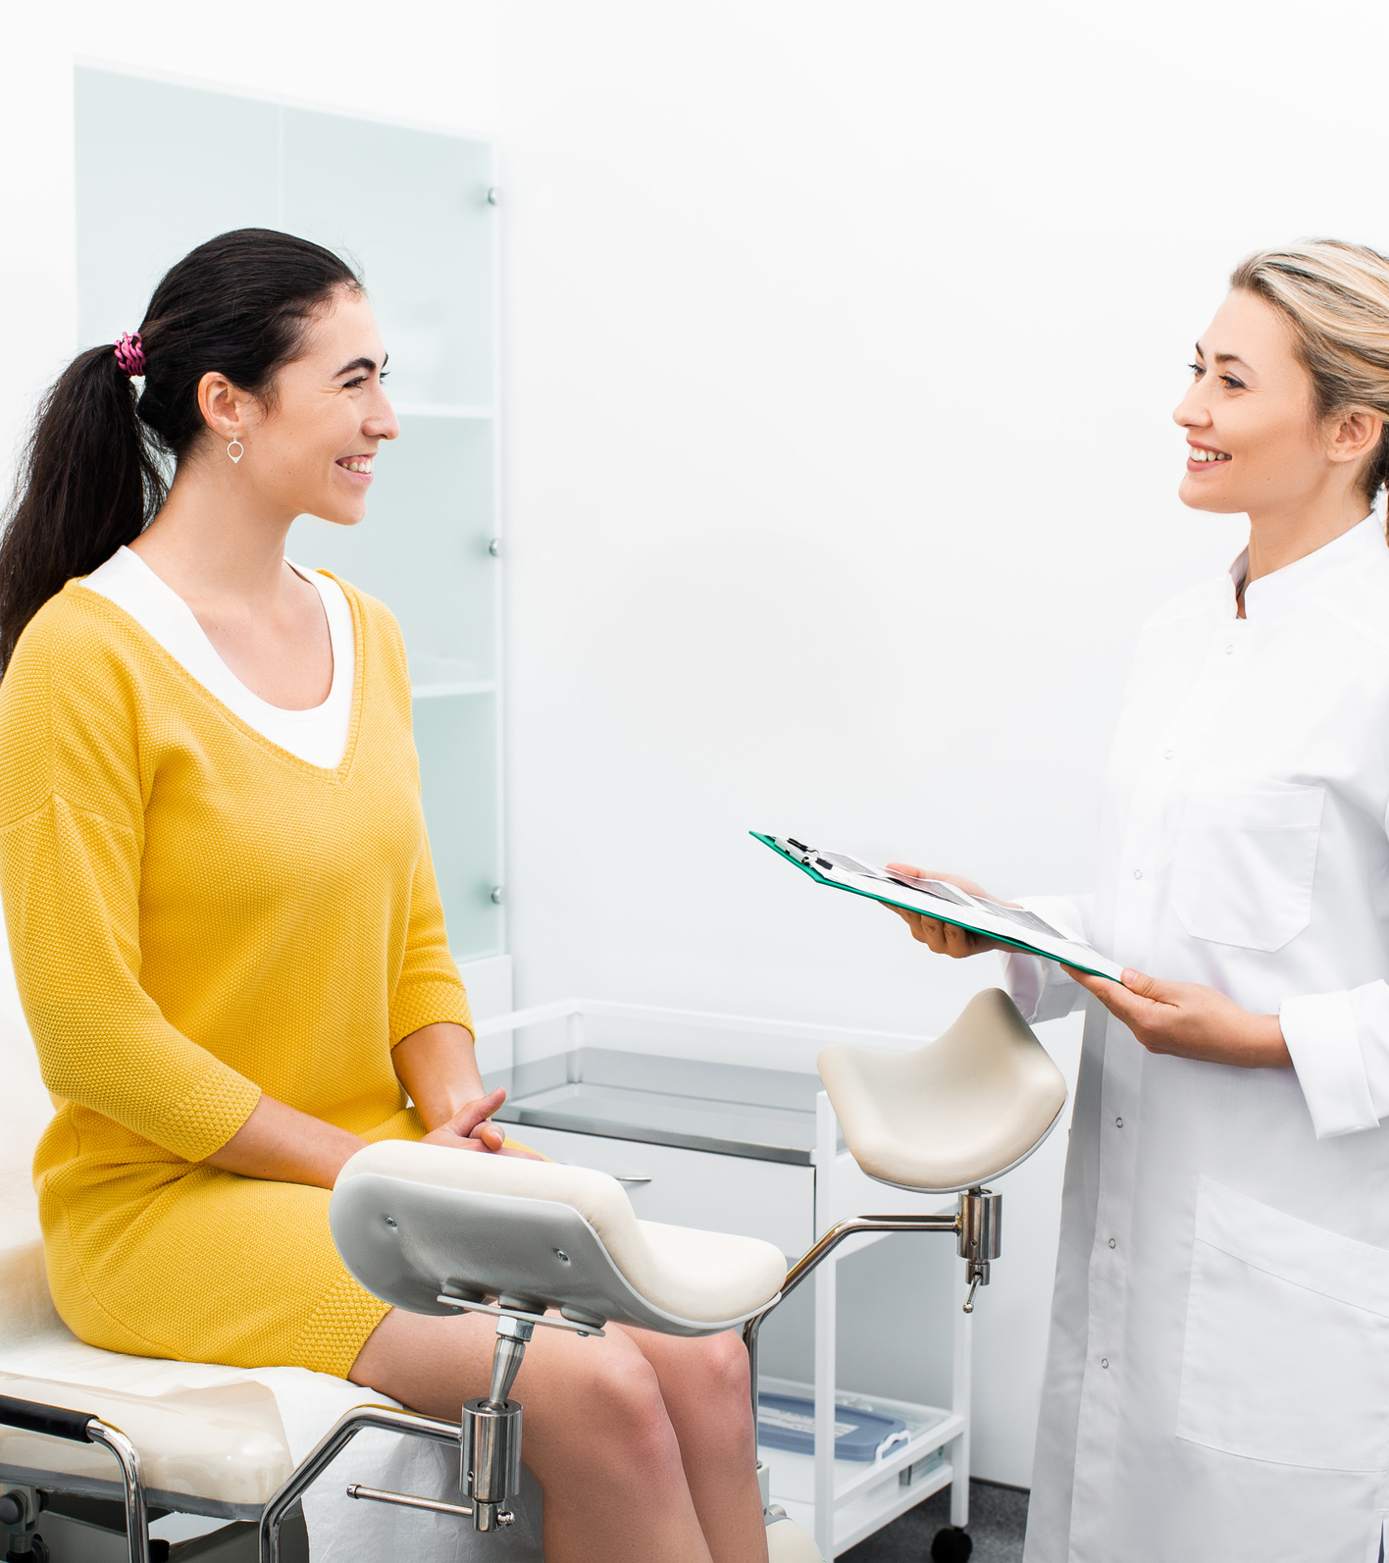
STEP 6
Talk with your doctor
Notes:
When the medical provider comes in, they will first go over the information that has been given to them and talk to you about any health concerns you may have. ​

Slide 13
STEP 6
Talk with your doctor
YOUR DOCTOR MAY ASK:
When was your last period?
Are you sexually active?
Are you using birth control?
Do you think you might be pregnant?
Notes:
They may ask a few questions such as:​
When was your last period?​
Are you sexually active?​
Are you using any type of birth control?​
Do you think you might be pregnant?​
These questions will help your medical provider provide the care that is best for you. It is important that you have a medical provider that you can trust. If you do not feel comfortable with your medical provider, consider switching to a different provider that you feel comfortable with.

Slide 14
STEP 7
Have the breast exam
Notes:
After that, the medical provider will usually do a breast exam. This exam is done to check for any abnormalities, including lumps or changes that might require more testing. Breast examinations are one of the most important ways to detect breast cancer. The earlier that breast cancer is found, the easier it can be to treat.​
​
During this exam, the medical provider may ask you to lie back on the exam table or ask that you remain sitting upright. They will then remove the top half of the gown to expose the breasts. You will be asked to either raise your arms, let them hang by your sides, or place your hands on your hips. These different positions help the medical provider examine the breasts thoroughly. Using just their hands, the medical provider will press and feel the breasts, nipples, and armpit region for abnormalities in shape, texture, or color. ​

Slide 15
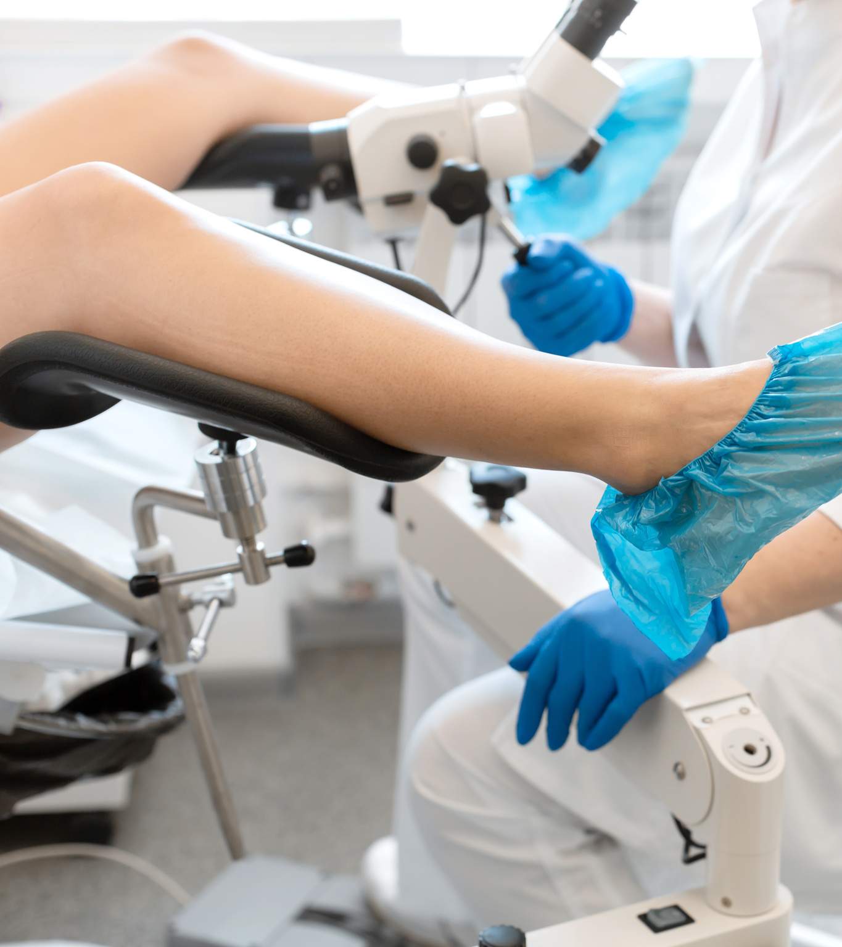
STEP 8
Have the pelvic exam and pap test
Notes:
After the breast exam, the medical provider will likely conduct a pelvic exam and a pap test. A pelvic exam is a regular part of your wellness exam, where the medical provider checks the health of your reproductive organs. During the pelvic exam, the medical provider may conduct a pap test to see if there are any abnormal cell changes on your cervix that could lead to cervical cancer. ​

Slide 16
STEP 8
Have the pelvic exam and pap test
STIRRUPS
Notes:
You will be asked to lie back on the exam table and place your feet in foot supports known as stirrups. This allows the medical provider to view the pelvic region. ​

Slide 17
STEP 8
Have the pelvic exam and pap test
Notes:
The medical provider will examine the outside of the vagina. They will then examine the inside. They do this by inserting a speculum, which is a medical instrument that comes in different sizes and makes it easier to see inside the vagina.​

Slide 18
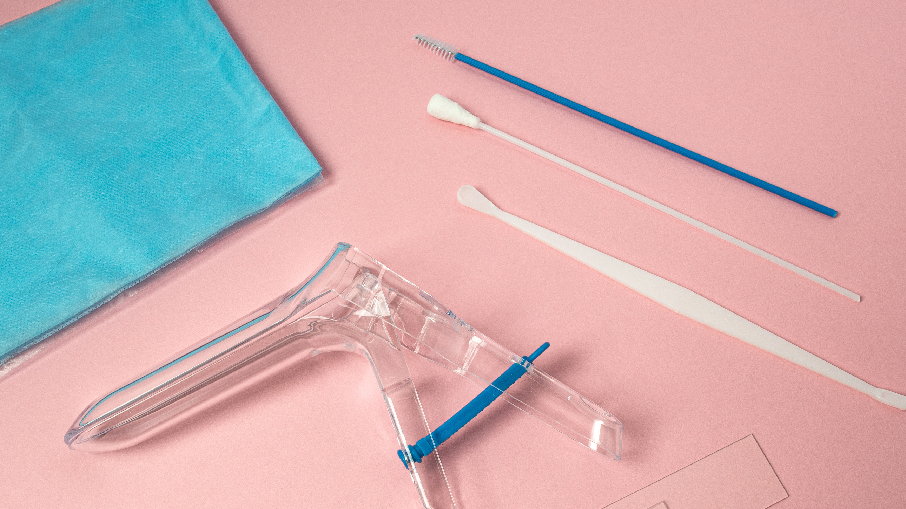
SPECULUM
Notes:
The medical provider will use a lubricant to make the speculum go in more easily. They may also ask you to relax as much as possible as this helps the speculum go in more easily.​
Once the speculum is in, the medical provider will examine the vagina and the cervix, check for abnormal growths, or take samples for testing. The speculum may feel cold or a little uncomfortable, and you should communicate any discomfort you have to your provider.

Slide 19
BRUSH
SPECULUM
Notes:
For the pap test, the medical provider will use a small brush to gently remove a sample from the cervix and back of the vagina. This sample is sent to a lab to be examined. During this time, they may also test you for any infections.

Slide 20
STEP 8
Have the pelvic exam and pap test
Notes:
While you are in the same position, the medical provider will examine the pelvic region for abnormalities. Because the pelvic organs such as the uterus and ovaries can't be seen from outside the body, the provider will use their hands to feel the stomach area and pelvis. The provider will insert one or two lubricated, gloved fingers into the vagina with one hand. At the same time using the other hand, the medical provider will press gently on the outside of your lower belly. This helps check for the size and shape of the uterus and ovaries and to check for any tender areas or abnormal growths.​

Slide 21
REMEMBER:
You have the right to ask your doctor questions
You should express any discomfort or hesitation so that your doctor can give you the best care possible
Notes:
The medical provider should explain the different procedures in the exam to you. You can also ask questions at any time during your appointment, even in the middle of a procedure. This is also true of expressing discomfort or hesitation about the procedures. Your comfort is very important and letting your medical provider know your questions or concerns helps them give you the best care possible.​

Slide 22
STEP 9
Discuss your results and next steps
Notes:
After the exams are done, the medical provider will give you any information that can be shared immediately. If they took any samples, they will tell you when you can expect the results. As the appointment comes to an end, the medical provider will talk about what to do next. This can include following specific instructions at home, scheduling a second appointment, or seeing a different doctor . They will then leave the room so you can get dressed in private. The medical provider may also discuss contraceptive options and the various modes of contraception available for you. It is your choice to have this conversation or accept the recommendations for contraception.

Slide 23
You did it! You took an important step to detecting health concerns early and taking care of your overall health.
Notes:
Having a women’s wellness exam every year is important for detecting health concerns early. By doing this, these concerns may be easier to cure or manage. It is also an important and private time to talk to a medical provider about your health worries or to ask questions so you have the information you need to take care of your health.​
Thank you for watching this series on Women's Wellness Exams!​

