Slide 1
Part 1: Introduction to
The Women's Wellness Exam

Slide 2
Women's Wellness Exams are an opportunity to review the overall health of a woman.
Notes:
A women’s wellness exam may include a check of your height and weight, your blood pressure and pulse, a review of your vaccines and other tests based on how you feel.

Slide 3
Women's Wellness Exams are an opportunity to review the overall health of a woman.
MAY INCLUDE:
Height and weight check, blood pressure and pulse check, vaccine review, or other tests
Notes:
A women’s wellness exam may include a check of your height and weight, your blood pressure and pulse, a review of your vaccines and other tests based on how you feel.

Slide 4
WOMEN'S WELLNESS EXAMS EXAMS USUALLY INCLUDE:
Breast exam
Pelvic exam
Pap test
Notes:
These exams also usually include three things: a breast exam, a pelvic exam, and a pap test.

Slide 5
WOMEN'S WELLNESS EXAMS EXAMS USUALLY INCLUDE:
START GOING TO WOMEN'S WELLNESS EXAMS WHEN:
Breast exam
Pelvic exam
Pap test
You become sexually active
OR
You are older than 21
Notes:
In the U.S., doctors recommend that women should start having a “women’s wellness exam” every year after they start having sex or when they reach 21 years of age.

Slide 6
This may be different from what is recommended or practiced in Afghanistan.
Notes:
This may be different than what is recommended or practiced in Afghanistan. The reason that doctors recommend regular women’s wellness exams for all women in the U.S., whether they are sexually active or not, is because these exams can catch health problems early, when they are easier to cure or manage.

Slide 7
Women's Wellness Exams can catch health problems early, when they are easier to cure or manage.
Notes:
These exams are not only done when you have a medical problem, but as a regular check of your overall health. They also provide a private space to talk to your doctor about any concerns or to ask questions concerning women’s health...

Slide 8
PLAN TO TALK TO YOUR DOCTOR IF YOU HAVE QUESTIONS ABOUT:
Abnormal periods and bleeding
Mood changes
Intense pain during menstruation
Family planning
Other health concerns
Notes:
including abnormal periods and bleeding, mood changes, intense pain during menstruation, family planning, and other health concerns.

Slide 9
For Afghan women who are new to the U.S. and need to know what to expect during a Woman's Wellness Exam
Notes:
This three-part video series is for Afghan women who are new to the US and helps explain what to expect during a “women’s wellness exam.”

Slide 10
For Afghan women who are new to the U.S. and need to know what to expect during a Woman's Wellness Exam
1
VIDEO 1: INTRODUCTION &
MEDICAL PROVIDERS
Helps introduce the importance of a women’s wellness exam and the types of providers who may do the exam.
Notes:
The first video will help Afghan women become more familiar with the types of providers who may do the exam.

Slide 11
For Afghan women who are new to the U.S. and need to know what to expect during a Woman's Wellness Exam
1
2
VIDEO 1: INTRODUCTION &
MEDICAL PROVIDERS
VIDEO 2: PATIENT RIGHTS
Helps introduce the importance of a women’s wellness exam and the types of providers who may do the exam.
Helps you understand your health rights in the U.S. and how to help your appointment go smoothly.
Notes:
The second video will help Afghan women understand their health rights in the U.S. and some things they can do to help the appointment go smoothly.

Slide 12
For Afghan women who are new to the U.S. and need to know what to expect during a Woman's Wellness Exam
1
2
3
VIDEO 1: INTRODUCTION &
MEDICAL PROVIDERS
VIDEO 2: PATIENT RIGHTS
VIDEO 3: ABOUT THE EXAM
Helps introduce the importance of a women’s wellness exam and the types of providers who may do the exam.
Helps you understand your health rights in the U.S. and how to help your appointment go smoothly.
Helps prepare you with details of
what happens during a women's wellness exam.
Notes:
The third video will explain in detail what happens during the women’s wellness exam.

Slide 13
Let's start!
Notes:
Let's get started!
Women’s medical needs are supported by several different types of medical providers in the U.S. While all these medical providers are knowledgeable about basic women’s health, each one also has their own specialty. Depending on the medical needs, women may consult with one or more of the following medical providers.

Slide 14
Primary Care
Physician
Notes:
Primary Care Physicians (or PCPs) are also known as general practitioners, family doctors, internists, or pediatricians. They take care of a wide range of health issues for people of every age. For women, the primary care physician is also the doctor most likely to perform a women’s wellness exam.

Slide 15
OB-GYN
Notes:
“OB/GYN” stands for Obstetricians/Gynecologists. An obstetrician is a type of doctor that supports women and their babies during pregnancy and childbirth.

Slide 16
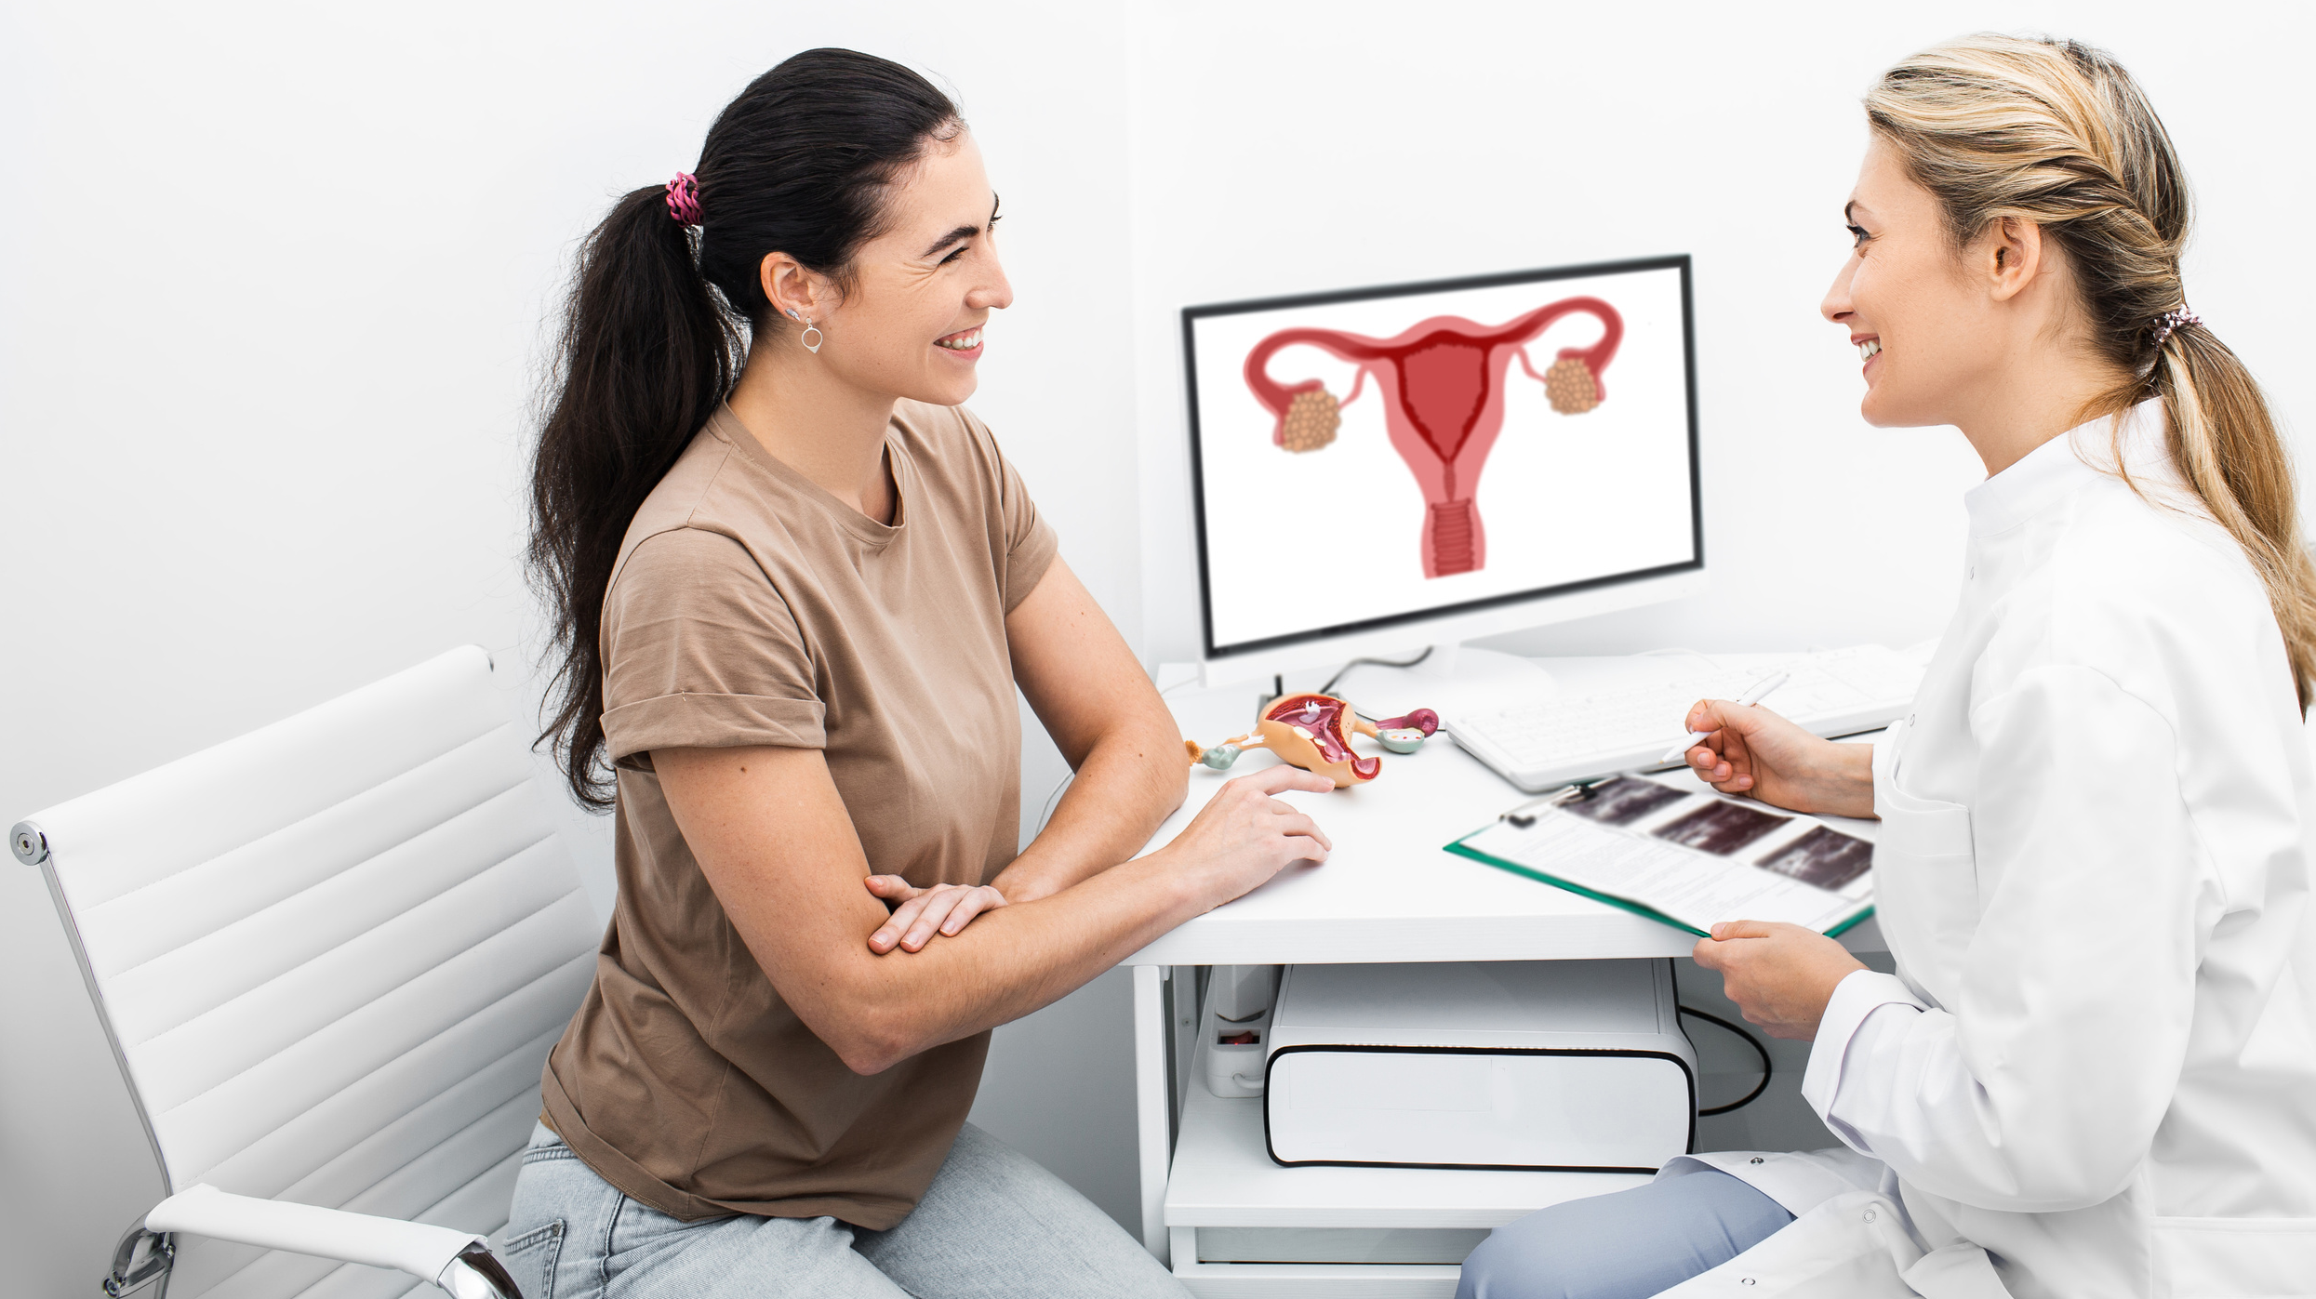
OB-GYN
Notes:
A gynecologist specializes in treating women’s reproductive health. Doctors specializing in these areas often do both, which is why they are called OB/GYNs.

Slide 17
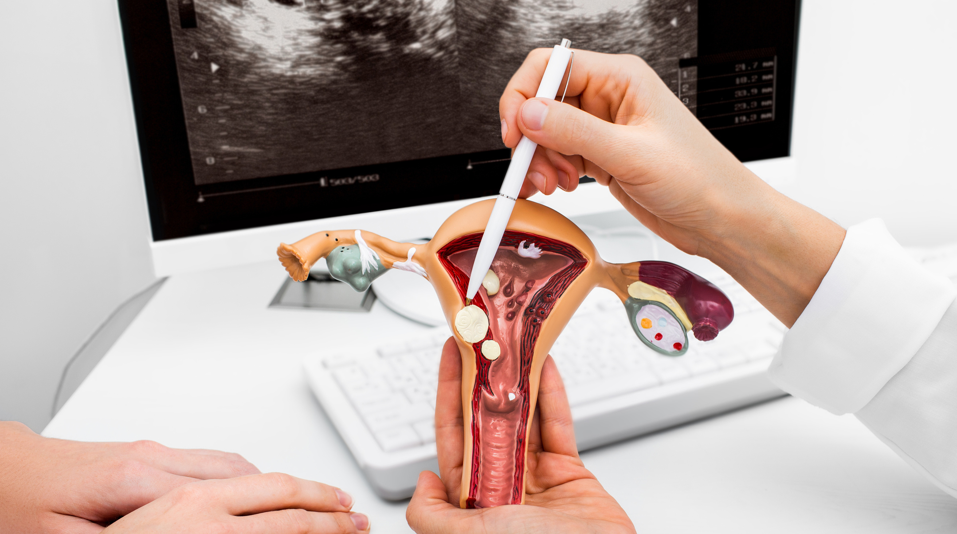
OB-GYN
Notes:
OB/GYNs care for women from adolescence through menopause and beyond.

Slide 18
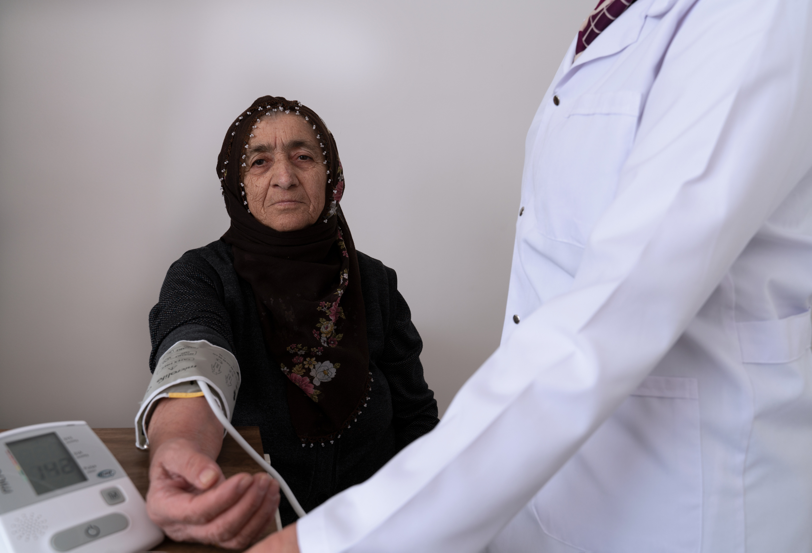
Nurse Practitioner
Notes:
Nurse practitioners are nurses who have received advanced training and degrees. They provide preventive care, diagnose health conditions, and manage treatment for people in their care. They may work independently or with doctors to provide a full range of healthcare services.

Slide 19
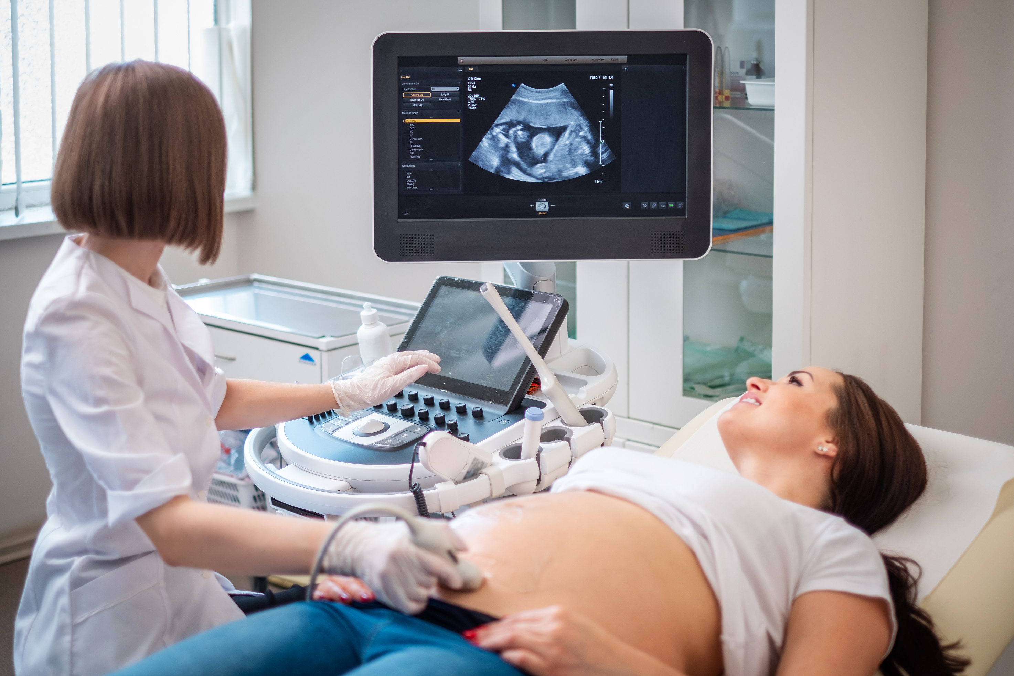
Midwife
Notes:
Midwives are healthcare providers who support pregnancy, childbirth, newborn care, and postpartum health. Midwives are usually not doctors, although some are nurses. Midwives may work with obstetricians and gynecologists (OB/GYNS) or on their own.

Slide 20
WATCH NEXT
2
VIDEO 2: PATIENT RIGHTS
Helps you understand your health rights in the U.S. and how to help your appointment go smoothly.
Notes:
You can receive care from many different types of providers in the U.S. No matter what type of provider you receive care from, all people in the U.S. have the same healthcare rights. Check out Video Two for more information about patient’s health care rights...

Slide 21
WATCH NEXT
2
3
VIDEO 2: PATIENT RIGHTS
VIDEO 3: ABOUT THE EXAM
Helps you understand your health rights in the U.S. and how to help your appointment go smoothly.
Helps prepare you with details of what happens during a women's wellness exam.
Notes:
...then view Video Three for detailed information about what happens during a women’s wellness exam in the U.S. Thanks for watching!

