Slide 1
Part 3:
What Happens at a Women's Wellness Exam

Slide 2
Women's Wellness Exams are an opportunity to review the overall health of a woman.
Notes:
In the U.S., doctors recommend that women who have sex or who are over the age of 21 have a “Women’s Wellness Exam” every year.
Women’s wellness exams are an opportunity to review the overall health of a woman. This includes physical health, mental health, and social situation.​

Slide 3
Women's Wellness Exams are an opportunity to review the overall health of your wife and other female family members.
MAY INCLUDE:
Height and weight check, blood pressure and pulse check, vaccine review, or other tests
Notes:
The physical exam may include a check of your wife’s height and weight, blood pressure and pulse, a review of her vaccines and other tests based on how your wife or
other female family members feel. ​

Slide 4
WOMEN'S WELLNESS EXAMS USUALLY INCLUDE:
Breast exam
Pelvic exam
Pap test
Notes:
These exams also usually include three things: a breast exam, a pelvic exam, and a pap test. ​

Slide 5
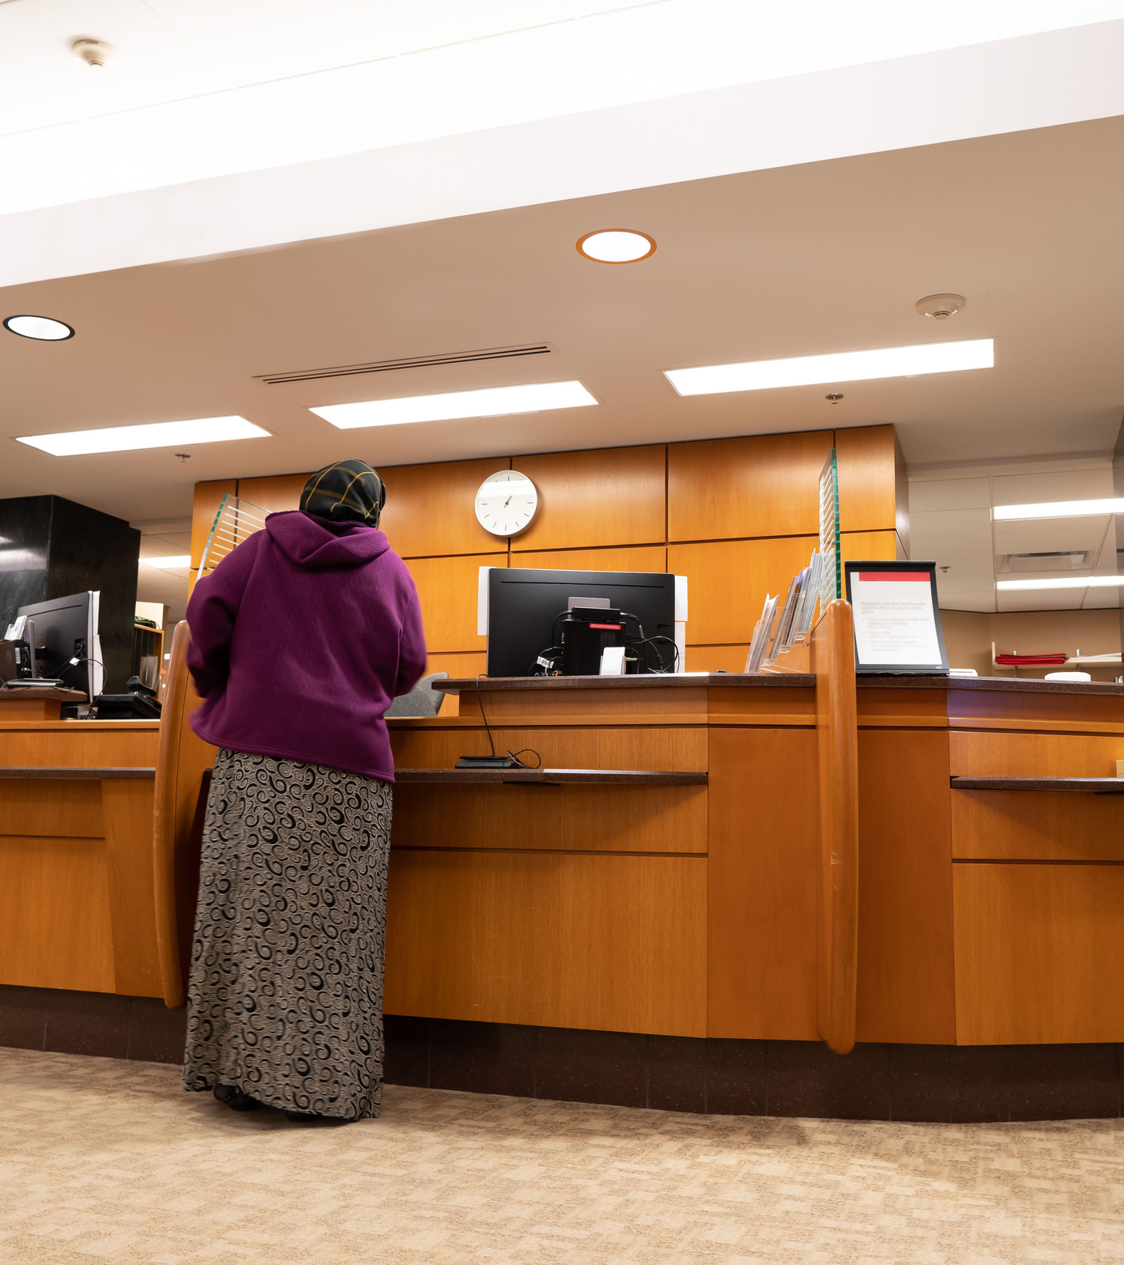
STEP 1
Your wife or female family member checks in at the front desk
Notes:
The first thing that happens at a Women’s Wellness Exam
is checking in at the front desk.
This means your wife goes to the front desk and gives the staff her name so they know your wife has arrived. ​

Slide 6
STEP 2
Your wife & female family members out necessary paperwork
Notes:
The staff may give your wife paperwork to fill out with
questions about your family medical history, any
medications she is taking, general demographic information, her menstrual cycle, whether or not she has had sex, and if she has been pregnant before.

Slide 7
REMEMBER:
Your wife or female family members must ask for an interpreter if they need one—their medical provider is required to provide care your wife understands.
Notes:
If your wife needs help reading and filling out the paperwork in your language, an interpreter should be able to help her.
If an interpreter is not there in person or needs to be called over the phone, she holds onto the paperwork until the interpreter is on the phone.​

Slide 8
STEP 3
Your wife or female family member waits in the lobby for their turn
Notes:
After checking in, your wife will wait in the lobby for her
name to be called.
When her name is called, a medical assistant or nurse will accompany her into the exam area of the clinic...​

Slide 9
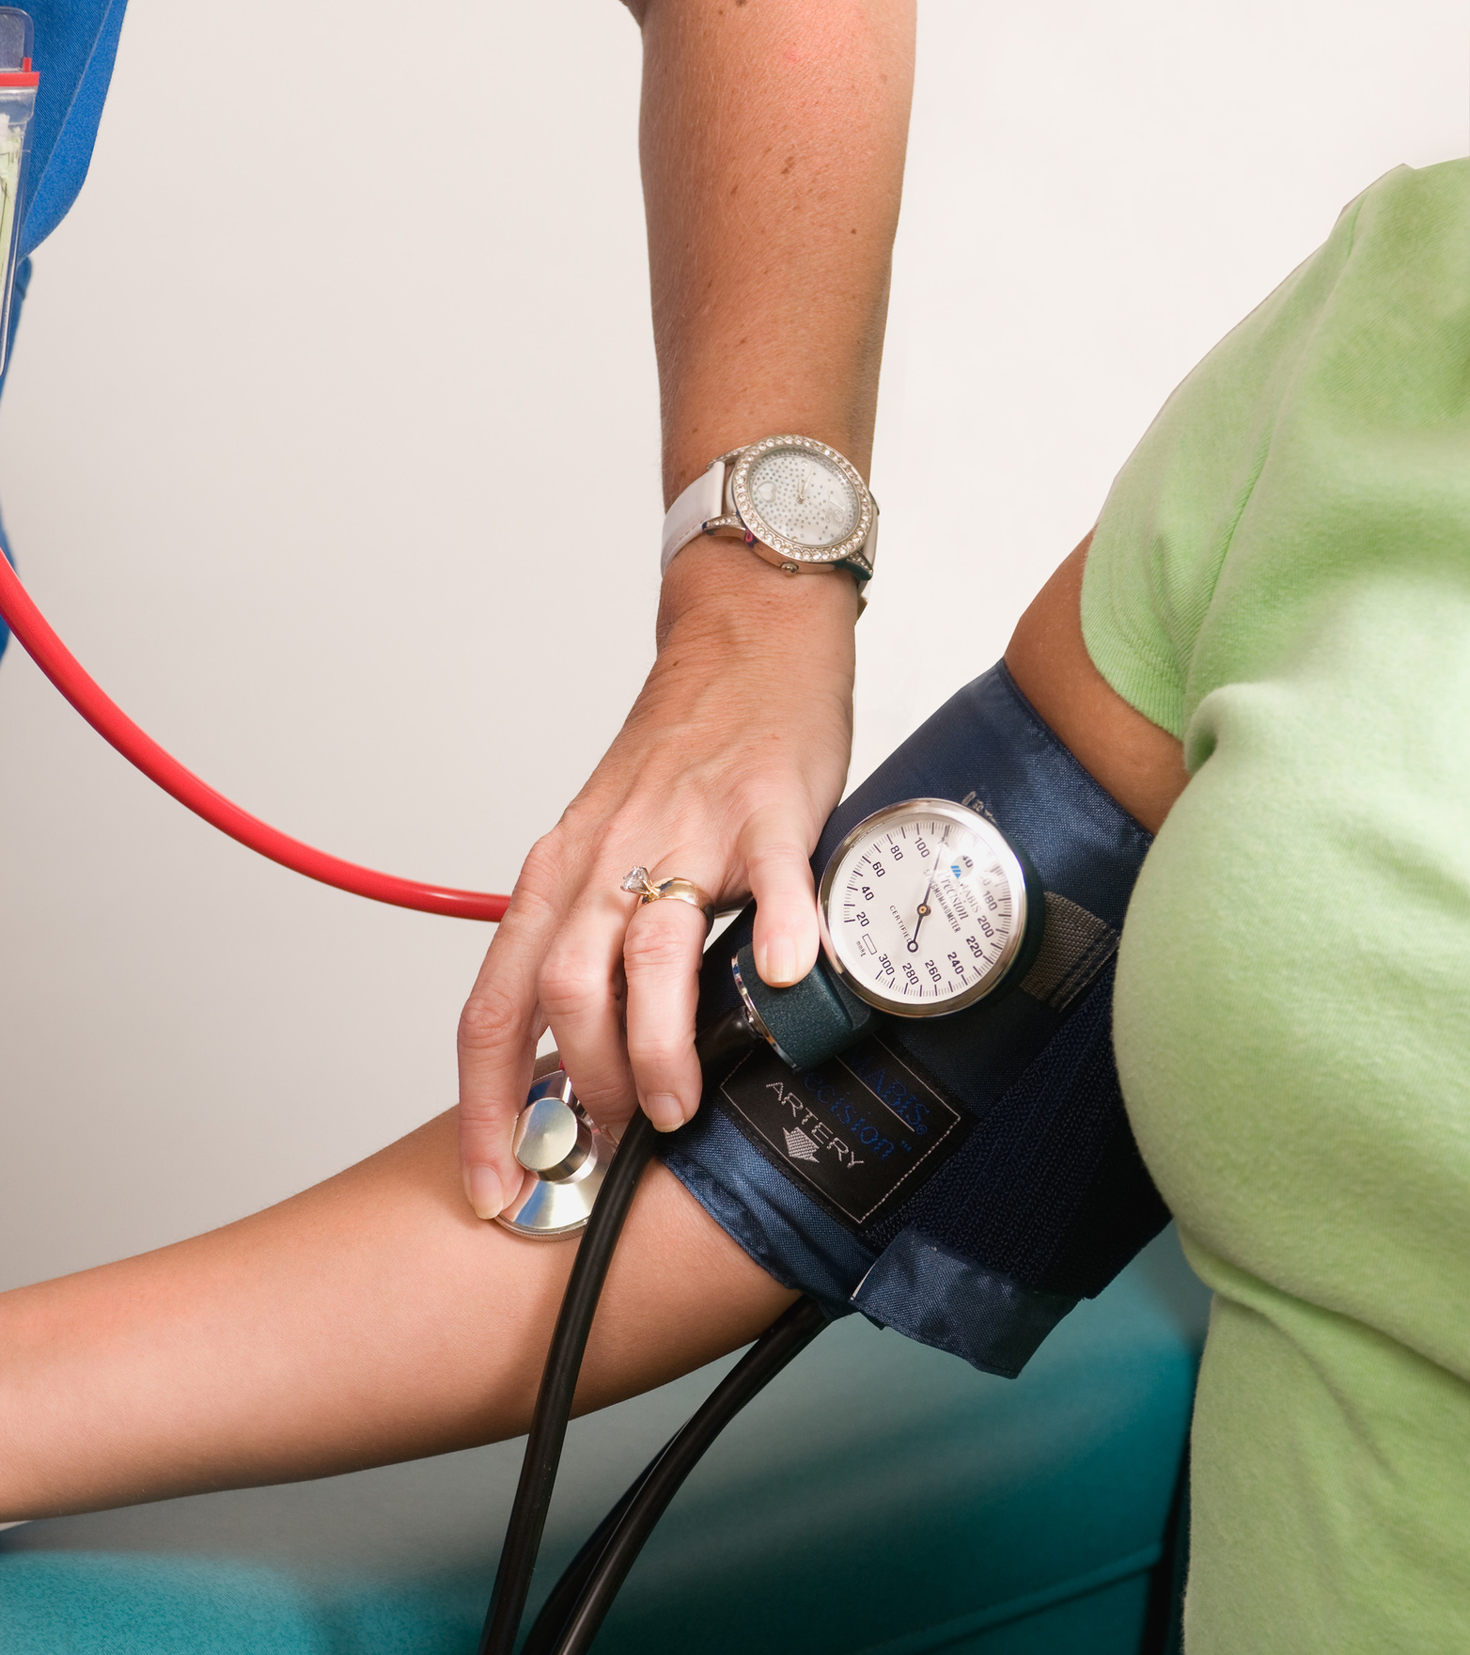
STEP 4
Have their vital signs checked
Notes:
... and take your wife’s height, weight, and blood pressure.
They will also ask your wife about her health concerns, her medical history, and your family’s medical history.
This information will be given to the medical provider. ​

Slide 10
STEP 5
Your wife or female family member changes into a medical gown
Notes:
Before the examination, the medical assistant or nurse will
provide your wife with a medical gown to change into.
They will leave the room to give your wife privacy while she changes. Once she is ready, she can sit and wait on the exam table.​

Slide 11
STEP 5
She changes into a medical gown
PAPER SHEET
Notes:
There is often a paper sheet on the exam table, which she can unfold and place over her lap for more privacy.​

Slide 12
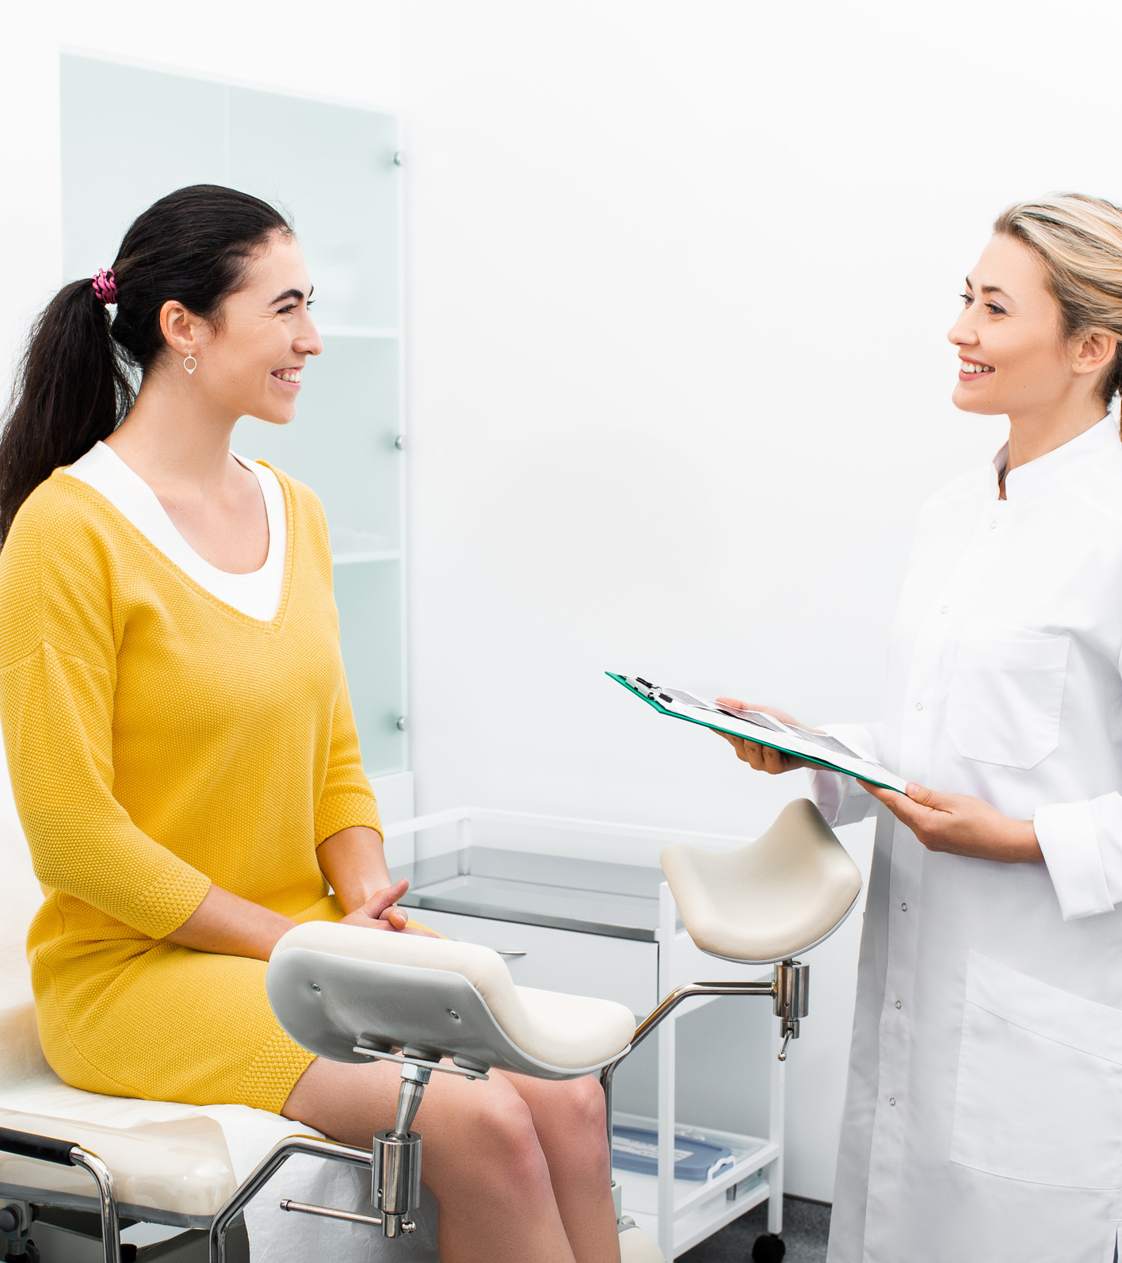
STEP 6
She talks with her doctor
Notes:
When the medical provider comes in, they will first go over the information that has been given to them and talk to your wife about any health concerns she may have. ​

Slide 13
STEP 6
She talks with her doctor
YOUR WIFE’S DOCTOR MAY ASK:
When was your wife’s last period?
Is your wife sexually active?
Is your wife using birth control?
Does your wife think she might be pregnant?
Notes:
They may ask a few questions such as:​
When was your wife’s last period?​
Is your wife sexually active?​
Is your wife using any type of birth control?​
Does your wife think she might be pregnant?​
These questions will help your wife’s medical provider provide the care that is best for her.
It is important that your wife has a medical provider that she can trust.
If your wife does not feel comfortable with her medical provider, consider switching to a different provider that she feels comfortable with.

Slide 14
STEP 7
Your wife undergoes the breast exam
Notes:
After that, the medical provider will usually do a breast exam.
This exam is done to check for any abnormalities, including lumps or changes that might require more testing.
Breast examinations are one of the most important ways to detect breast cancer. The earlier that breast cancer is
found, the easier it can be to treat.​
​During this exam, the medical provider may ask your wife to lie back on the exam table or ask that she remain sitting upright.
They will then remove the top half of the gown to expose the breasts. Your wife will be asked to either raise her arms, let them hang by her sides, or place her hands on her hips.
These different positions help the medical provider examine the breasts thoroughly.
Using just their hands, the medical provider will press and feel the breasts, nipples, and armpit region for abnormalities in shape,
texture, or color.

Slide 15
STEP 8
Your wife undergoes the pelvic exam and pap test
Notes:
After the breast exam, the medical provider will likely
conduct a pelvic exam and a pap test.
A pelvic exam is a regular part of the women’s wellness exam, where the medical provider checks the health of a woman’s reproductive organs.
During the pelvic exam, the medical provider may conduct a pap test to see if there are any abnormal cell changes on her cervix that could lead to cervical cancer.

Slide 16
STEP 8
Your wife undergoes the pelvic exam and pap test
STIRRUPS
Notes:
Your wife will be asked to lie back on the exam table and
place her feet in foot supports known as stirrups.
This allows the medical provider to view the pelvic region. ​
The medical provider will explain all the procedure step by step to your wife so she understands it.

Slide 17
STEP 8
Your wife undergoes the pelvic exam and pap test
Notes:
When the medical provider examines the reproductive organs

Slide 18
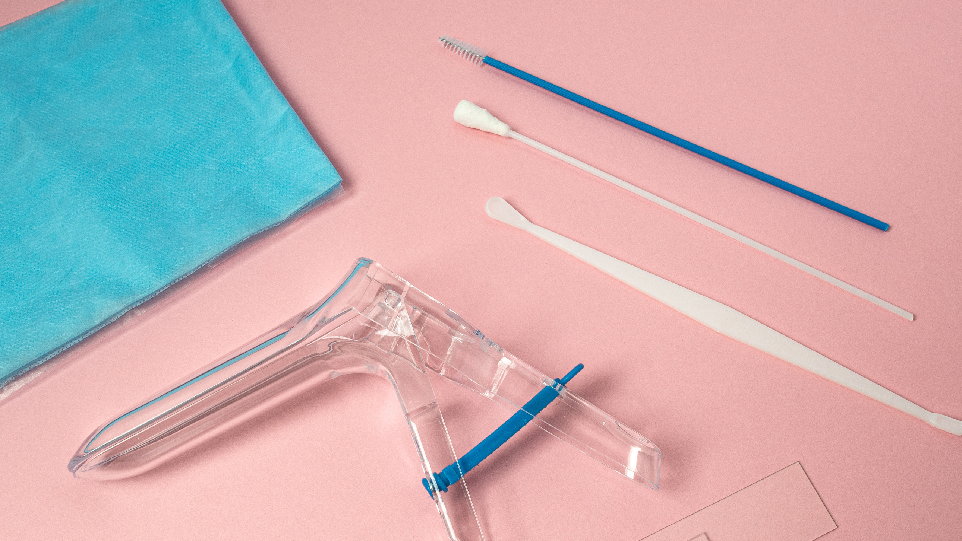
SPECULUM
Notes:
The medical provider will examine the vagina and the cervix, check for abnormal growths, or take samples for testing.

Slide 19
BRUSH
SPECULUM
Notes:
For the pap test, the medical provider will use a small brush
to gently remove a sample from the cervix and back of the vagina.
This sample is sent to a lab to be examined.
During this time, they may also test your wife for any
infections.

Slide 20
STEP 8
Your wife undergoes the pelvic exam and pap test
Notes:
While your wife is in the same position, the medical
provider will examine the pelvic region for abnormalities.
Because the pelvic organs such as the uterus and ovaries can't be seen from outside the body, the provider will use their hands to feel the stomach area and pelvis.
This helps check for the size and shape of the uterus and
ovaries and to check for any tender areas or abnormal
growths.​

Slide 21
YOUR WIFE MUST REMEMBER:
Your wife has the right to ask her doctor questions
Your wife should express any discomfort or hesitation so that her doctor can give her the best care possible
Notes:
The medical provider should explain the different procedures in the exam to your wife.
Your wife can also ask questions at any time during her appointment, even in the middle of a procedure.
This is also true of expressing discomfort or hesitation about the procedures.
Your wife’s comfort is very important and letting her medical provider know her questions or concerns helps them give her the best care possible.

Slide 22
STEP 9
Discuss your wife’s results and next steps
Notes:
After the exams are done, the medical provider will give your wife any information that can be shared immediately.
If they took any samples, they will tell your wife when she can expect the results. As the appointment comes to an end, the medical provider will talk about what to do next.
This can include following specific instructions at home, scheduling a second appointment, or seeing a different doctor.
They will then leave the room so your wife can get dressed in private.
The medical provider may also discuss contraceptive options and the various modes of contraception available for your wife.
It is your wife’s choice to have this conversation or accept the recommendations
for contraception.

Slide 23
You did it! You took an important step to detecting health concerns early and taking care of your wife’s and other female family members’ overall health.
Notes:
Having a women’s wellness exam every year is important
for detecting health concerns early.
By doing this, these concerns may be easier to cure or manage. It is also an important and private time to talk to a medical provider about your wife’s health worries or to ask questions so your wife has the information she needs to take care of your wife’s health.
Thank you for watching this series on Women's Wellness
Exams!​

