Slide 1
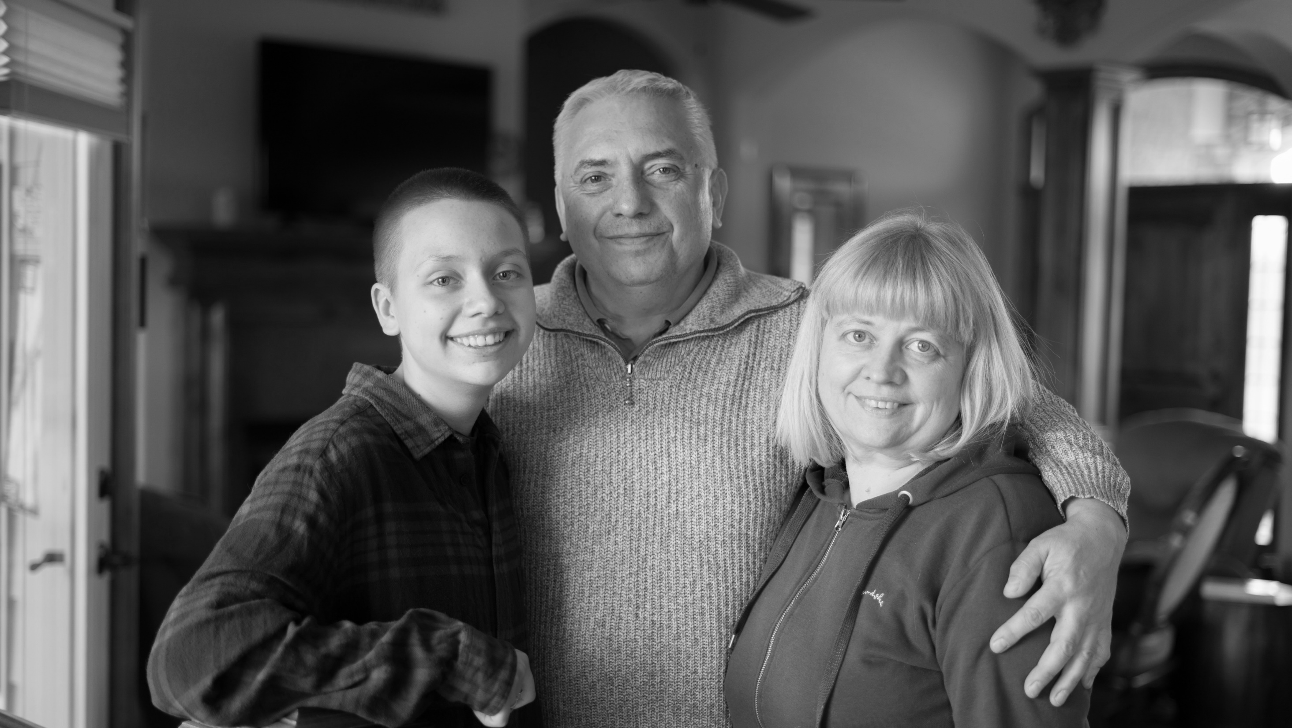
Welcome!

Slide 2
Uniting for Ukraine Health Requirements for Maintaining Parolee Status in the U.S.
Last Updated: Feb. 9, 2024
National Resource Center for Refugees, Immigrants and Migrants

Slide 3
What is Humanitarian Parole?
Last Updated: Feb. 9, 2024
National Resource Center for Refugees, Immigrants and Migrants

Slide 4
What is Humanitarian Parole?
Granted by the U.S. Government
Allows some people from other countries experiencing crisis and conflict to come to the U.S. temporarily.
For Ukrainians displaced by the current conflict:
Uniting for Ukraine (U4U)
Two years
Three health requirements
Last Updated: Feb. 9, 2024
National Resource Center for Refugees, Immigrants and Migrants
Notes:
Humanitarian Parole allows some people from other countries experiencing crisis or conflict to come to the U.S. and stay for a set period of time. In April 2022, the U.S. Government created a program to allow Ukrainians displaced by the war in Ukraine to apply for humanitarian parole and come to the U.S. for two years. That program is called Uniting for Ukraine (U4U).
The U4U program requires everyone who comes to the U.S. through the program to complete three health requirements. It is essential to meet these health requirements because not doing so will put your status at risk.

Slide 5
Health Requirements of U4U
Last Updated: Feb. 9, 2024
National Resource Center for Refugees, Immigrants and Migrants

Slide 6
Health Requirements of U4U
Pre-travel attestation:
Measles vaccine
Polio vaccine
COVID-19 vaccine
Attestation required within 90 days after U.S. arrival:
Tuberculosis screening (IGRA blood test)
If applicable:
Polio vaccine
COVID-19 vaccine
Attestations must be completed in your USCIS account.
Last Updated: Feb. 9, 2024
National Resource Center for Refugees, Immigrants and Migrants
Notes:
Prior to entering the U.S. through the U4U program, you are required to confirm that you have been vaccinated against Measles, Polio, and have received at least one dose of the COVID-19 vaccine. Once you have been paroled into the U.S. under U4U, you must complete a second medical attestation in your U.S. Citizenship and Immigration Services (USCIS) account within 90 days of arrival. Here, you will need to attest that you have completed the Tuberculosis screening, specifically the interferon-gamma release assay (IGRA) blood test, as well as the second dose of the COVID-19 vaccine (if you haven’t received it already).
Some exceptions may apply to these requirements. For more information, please see the Uniting for Ukraine Vaccine Attestation page on the USCIS website, available in English, Ukrainian, and Russian.

Slide 7
Pre-travel Attestation: Measles Vaccine
All individuals 12 months and older must complete at least one dose of the Measles vaccine.
Some exceptions may apply (please see the USCIS U4U Vaccine Attestation page).
Last Updated: Feb. 9, 2024
National Resource Center for Refugees, Immigrants and Migrants
Notes:
Measles is a very contagious virus that can lead to respiratory illness and complications. Symptoms often include, but are not limited to, high fever, cough, runny nose, and rash. Measles can be dangerous, especially for babies and young children. To prevent the spread of Measles, the Measles vaccine is a pre-travel health requirement. Prior to coming to the U.S., all individuals who are 12 months and older will need to attest that they have received at least one dose of the Measles vaccine. Some exceptions may apply to this requirement. For more information, please see the Uniting for Ukraine Vaccine Attestation page on the USCIS website.

Slide 8
Pre-travel Attestation: COVID-19 Vaccine
Everyone six months and older must complete at least one dose of a COVID-19 vaccine pre-travel.
This vaccine must be approved by the U.S. Food and Drug Administration (FDA) or the World Health Organization Emergency Use Listing (WHO EUL).
All individuals must attest that they will complete the recommended primary vaccine series upon arrival to the U.S.
Some exceptions may apply (please see the USCIS U4U Vaccine Attestation page).
Last Updated: Feb. 9, 2024
National Resource Center for Refugees, Immigrants and Migrants
Notes:
Over 1 million people have died of COVID-19 in the U.S. To help protect the public, the U.S. Government requires Ukrainians with humanitarian parole to be vaccinated for COVID-19. This means all individuals six months and older must complete at least one dose of a U.S. Food and Drug Administration (FDA) or World Health Organization Emergency Use Listing (WHO EUL) approved COVID-19 vaccine. Children too young to be vaccinated before arriving to the U.S. must start their COVID-19 vaccine series within 90 days of arrival to the U.S., or when they reach the eligible age (6 months). Some exceptions may apply to this requirement. For more information, please see the Uniting for Ukraine Vaccine Attestation page on the USCIS website.
Over 12.7 billion people around the world have gotten the COVID-19 vaccine. It is safe and effective at reducing serious illness and death. COVID-19 vaccines are available at pharmacies and many medical clinics in the U.S.

Slide 9
Pre-travel Attestation: Polio Vaccine
All individuals 6 weeks and older must complete the Polio vaccine.
Some exceptions may apply:
If the individual is younger than 6 weeks old
If the vaccine is not approved or licensed for the individual’s age group
If the individual qualified for a medical exception
Please see the U4U Vaccine Attestation page for more information.
Last Updated: Feb. 9, 2024
National Resource Center for Refugees, Immigrants and Migrants
Notes:
Polio is a severe illness that can cause long-term disability or even death. To ensure that Polio remains under control in the U.S., the Government requires Ukrainian humanitarian parolees over the age of 6 weeks to receive the Polio vaccine prior to arrival to the U.S. Babies too young to be vaccinated prior to travel must have attestation completed confirming that they have been vaccinated against Polio within 90 days after arriving to the U.S. Some exceptions may apply to this requirement. For more information, please see the Uniting for Ukraine Vaccine Attestation page on the USCIS website.
Polio vaccines are safe and effective. They are available at pharmacies and many medical clinics in the U.S.

Slide 10
Attestation Within 90 Days After U.S. Arrival: Tuberculosis Screening
Everyone two years and older must complete a Tuberculosis (TB) screening within 90 days after arrival.
Interferon-gamma release assay (IGRA) blood test
Available at most public health and community health clinics.
Last Updated: Feb. 9, 2024
National Resource Center for Refugees, Immigrants and Migrants
Notes:
Tuberculosis is an airborne disease that can cause severe illness and death. The Government requires Ukrainian humanitarian parolees two years and older to be screened for Tuberculosis within 90 days after arriving to the U.S. This screening must be completed using an interferon-gamma release assay (IGRA) blood test. When you make your screening appointment, make sure to ask for an IGRA blood test.
Children under two years old qualify for an exception to this health requirement.

Slide 11
Tuberculosis Attestation
Everyone two years and older will have to declare one of three IGRA blood test results:
Negative
Indeterminate (uncertain): Agree to follow up with a doctor to complete any additional testing and treatment.
Positive: Agree to receive a chest x-ray, and if abnormal or other symptoms are present, to follow the isolation and treatment recommendations.
Please remember to keep all test results!
Last Updated: Feb. 9, 2024
National Resource Center for Refugees, Immigrants and Migrants
Notes:
After you complete the IGRA blood test, you will receive your test results. Based on these results, you will need to attest to one of three things:
The test result was negative: This means you do not have tuberculosis.
The test result was indeterminate: This means the blood test results came back uncertain. If this happens, on the attestation, you will need to agree to have more testing and follow-up with a medical professional. The place where you got tested will tell you what steps to take next.
The test result was positive: This means you tested positive for tuberculosis. If this happens, you will need to get a chest x-ray to see if the tuberculosis is active or not. If you receive a positive test result, you must attest that you will get treated and follow medical recommendations.
It is important to keep a copy of all test results and documentation to prove that you have followed all the recommended testing and treatment.

Slide 12
Attestation Within 90 Days After U.S. Arrival: Polio Vaccine
This is a pre-arrival requirement for all individuals 6 weeks and older.
If an individual was too young to receive the vaccine or if the vaccine was not approved for the age group, they must complete this vaccine within 90 days after arriving to the U.S.
Some exceptions may apply (please see the USCIS U4U Vaccine Attestation page).
Last Updated: Feb. 9, 2024
National Resource Center for Refugees, Immigrants and Migrants
Notes:
Polio is a severe illness that can cause long-term disability or even death. To ensure that Polio remains under control in the U.S., the Government requires Ukrainian humanitarian parolees over the age of 6 weeks to receive the Polio vaccine prior to arrival to the U.S. However, if your baby was too young to be vaccinated prior to travel or if the vaccine was not approved or licensed for use where you were residing, they must have attestation completed confirming that they have been vaccinated against Polio within 90 days after arriving to the U.S. Some exceptions may apply to this requirement. For more information, please see the Uniting for Ukraine Vaccine Attestation page on the USCIS website.
Polio vaccines are safe and effective. They are available at pharmacies and many medical clinics in the U.S.

Slide 13
Attestation Within 90 Days After U.S. Arrival: COVID-19 Vaccine
The first dose of the COVID-19 vaccine is a pre-arrival requirement for all individuals 6 months and older.
All individuals must attest that they will complete the recommended primary vaccine series upon arrival to the U.S.
If individual was too young to receive the first dose or if the vaccine was not approved for the age group, they must receive the first dose within 90 days after arriving to the U.S. and complete the primary series.
Some exceptions may apply (please see the USCIS U4U Vaccine Attestation page).
Last Updated: Feb. 9, 2024
National Resource Center for Refugees, Immigrants and Migrants
Notes:
As discussed earlier, all individuals six months and older must complete at least one dose of a U.S. Food and Drug Administration (FDA) or World Health Organization Emergency Use Listing (WHO EUL) approved COVID-19 vaccine pre-travel. However, children too young to be vaccinated before arriving to the U.S. and individuals who were residing in places where the COVID-19 vaccine was not approved or licensed for their age group, must start their COVID-19 vaccine series within 90 days of arrival to the U.S., or when they reach the eligible age (6 months). Everyone must also attest that they will complete the recommended primary vaccine series according to current Centers for Disease Control and Prevention (CDC) guidelines after arriving to the U.S. Some exceptions may apply to this requirement. For more information, please see the Uniting for Ukraine Vaccine Attestation page on the USCIS website.

Slide 14
Finding Vaccines and TB Screening
Last Updated: Feb. 9, 2024
National Resource Center for Refugees, Immigrants and Migrants

Slide 15
Finding Vaccines and TB Screening
Ask your caseworker
Find a Federally Qualified Health Center https://findahealthcenter.hrsa.gov/
Call 2-1-1
If you don’t speak English, you can request an interpreter by saying, “No English. I need a Ukrainian interpreter.”
Contact the Virtual Resettlement Line
(212) 551-3010 (available Monday-Friday, 9 am - 5 pm EST)
VRL@rescue.org
Last Updated: Feb. 9, 2024
National Resource Center for Refugees, Immigrants and Migrants
Notes:
There are several places you can go to get needed vaccines or to get your TB test.
Ask your caseworker
Contact the Virtual Resettlement Line
Call (212) 551-3010 (available Monday-Friday, 9 am - 5 pm EST) or email VRL@rescue.org
Find a Federally Qualified Health Center (https://findahealthcenter.hrsa.gov/)
Call 2-1-1, a phone number for information and referrals to local community services.
If you don’t speak English, say, “No English. I need a Ukrainian interpreter.”
Then, wait on the line. It may take a few minutes.

Slide 16
Paying for Vaccines and Screening
Last Updated: Feb. 9, 2024
National Resource Center for Refugees, Immigrants and Migrants

Slide 17
Paying for Vaccines and Screening
Medicaid
People arriving on or after October 1, 2023, may not qualify.
Federally Qualified Health Center
Talk to your caseworker
Last Updated: Feb. 9, 2024
National Resource Center for Refugees, Immigrants and Migrants
Notes:
Most Ukrainians who have come to the U.S. through the U4U program have government health insurance called Medicaid. Medicaid is a type of health insurance the U.S. government provides for people who may qualify for free or low-cost medical care. Once you receive your insurance card number, you can schedule an appointment with a primary care physician and get a referral for a vaccine or screening.
However, there are some exceptions to this. Some Ukrainians who have come to the U.S. under the U4U program may no longer have Medicaid because they have gotten a job and earn too much money to qualify for government health insurance. In addition, if you came to the U.S. after October 1, 2023, you are not eligible for the Office of Refugee Resettlement (ORR) benefits, which includes Medicaid. There are some exceptions so speak to your caseworker for more information.
Even if you don’t have Medicaid, there are several options. Most Federally Qualified Health Centers have services that are free or at significantly reduced costs. You can also check with your caseworker to learn about local available options. You may also consider calling the Virtual Resettlement Line or 2-1-1.
COVID-19 vaccines can be free, depending on where you live and if you have insurance. Ask your caseworker if you can get a free vaccine and where to get vaccinated.
Tuberculosis (TB) tests can be done at a primary care facility, a refugee clinic, a state health department clinic, or a diagnostic laboratory. If you need a doctor’s referral, you can obtain it from your primary care physician under Medicaid. Your insurance may cover the test. If you do not have health insurance, a test will cost between $80 and $200. You may be able to find lower-cost tests at community clinics or health departments near you.
For facilitators: Optional coverage for Medicaid varies per state (https://www.medicaid.gov/medicaid/benefits/index.html). Your script for mandatory coverage can be tailored using the complete benefits list (https://www.medicaid.gov/medicaid/benefits/mandatory-optional-medicaid-benefits/index.html).

Slide 18
Where Do I Attest?
USCIS account
Last Updated: Feb. 9, 2024
National Resource Center for Refugees, Immigrants and Migrants
Notes:
You can attest to completing these requirements online in your USCIS account.
Confirming that you have completed all health requirements is simple. You only need to log into your USCIS online account, where you will find the form to confirm that you have completed the health requirements.
For facilitators: A preview of the attestation options can be found in English, Ukrainian, and Russian. When conducting the presentation, you should demonstrate the preview.
English: https://www.uscis.gov/humanitarian/uniting-for-ukraine/uniting-for-ukraine-vaccine-attestation
Ukrainian: https://www.uscis.gov/humanitarian/atestaciya-vakcin
Russian: https://www.uscis.gov/humanitarian/uniting-for-ukraine/uniting-for-ukraine-vaccine-attestation-russian

Slide 19
What Happens If I Don’t Follow Requirements?
Your humanitarian parole may be at risk
Last Updated: Feb. 9, 2024
National Resource Center for Refugees, Immigrants and Migrants
Notes:
Right now, the U.S. Government is mostly taking people’s word for whether they have fulfilled the requirements for U4U. However, this could change at any time. If someone did not complete the requirements, it could put their humanitarian parole at risk. If someone lied and the government found out, it could also put their humanitarian parole, or any future application for asylum or any other immigration benefit, at risk. While it is uncertain what the government might do if they found out someone was untruthful or did not meet the requirements, there is a risk that it could result in the termination of parole or denial of subsequent applications for immigration benefits.

Slide 20
Thank you
Last Updated: Feb. 9, 2024
National Resource Center for Refugees, Immigrants and Migrants

